Slide 1
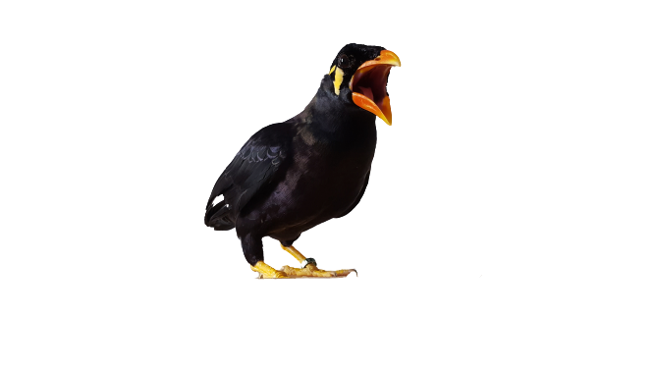

SICB Talk - 6 min
MORPHO-FUNCTIONAL STUDY OF BIRDS VOCAL SYSTEM:
INFLUENCE OF PHYLOGENY
ON ACOUSTIC PARAMETERS
Author : Irina DELAMARE
Rachel OLSON, and Pauline PROVINI
at Center for Research and Interdisciplinarity
(CRI PARIS)
Notes:
Have you ever wondered how bird sing? If you are here today, I suppose that, like me, you have. Let me introduce myself, real quick. I am Irina Delamare and I am fascinated by birds. I was lucky to do a 4 months internship as an undergraduate student with Pauline Provini at the Center for Research and Interdisciplinarity, in Paris, where I pursued a preliminary morphofunctional study of birds vocal system and, more precisely, explored the influence of phylogeny on acoustic parameters! And here on the right of the screen, I present to you Tomi, my pet myna. He is a really nice bird that produces an amazing diversity of sounds. Here, let me show you

Slide 2

Notes:
Have you noticed anything? let me give you a hint.

Slide 3
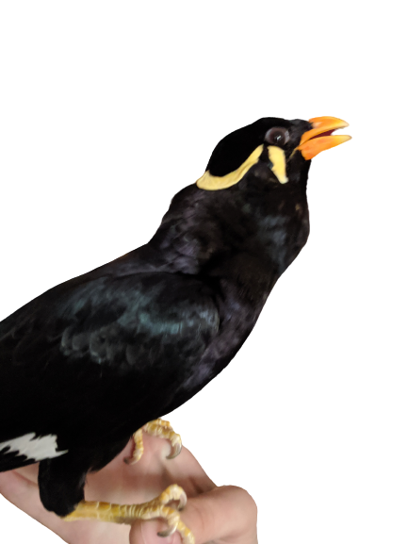
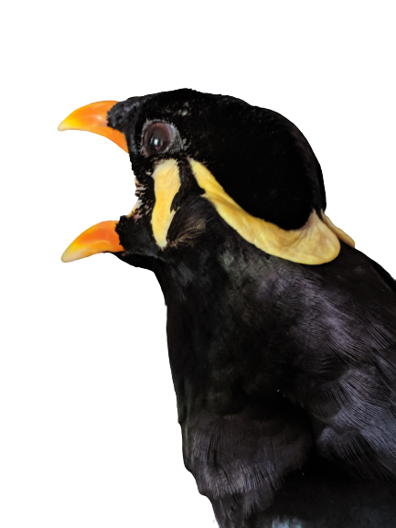
LOW PITCH
HIGH PITCH
Notes:
*We can clearly see a visual difference between low and high pitches. As you might have read on my abstract, I was supposed to quantify the volume difference in the vocal tract of birds between low and high pitches. Sadly, due to COVID-19 restrictions, I was not able to gather birds and materials for this study. So, I looked at the influence of the phylogeny on acoustic parameters!

Slide 4
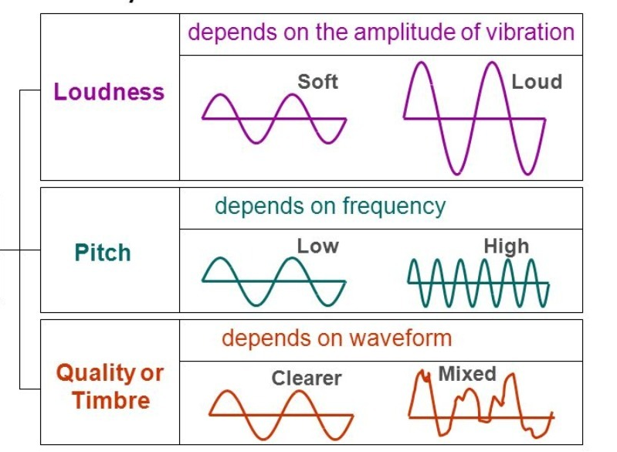
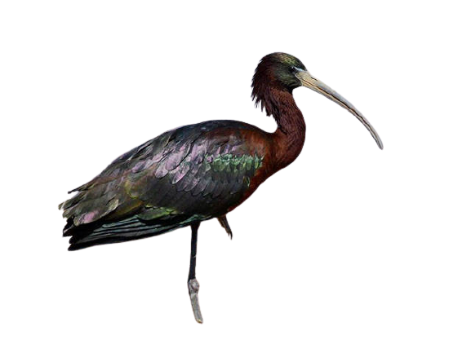
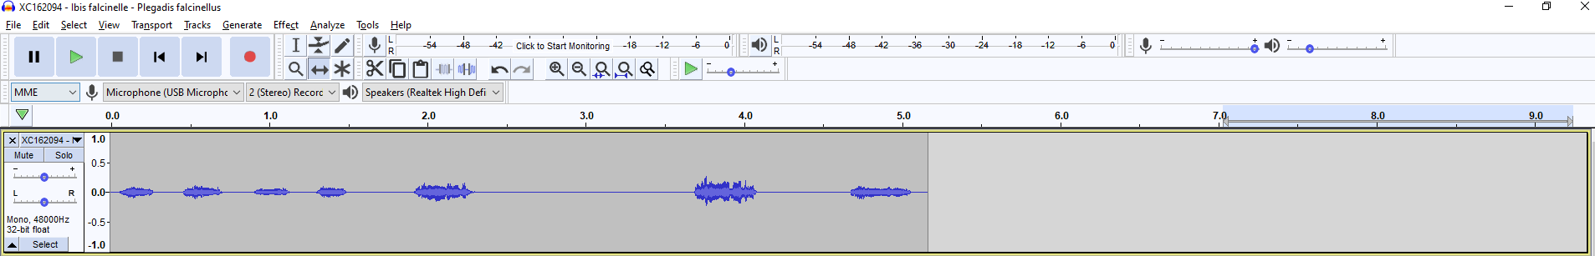
Mean
Min
Max
130 Recordings
Spectrogram of Plegadis falcinellus
Notes:
I gathered a total of 130 recordings each from different species. From each recordings, I extracted multiple parameters such as the mean, min, max pitch, loudness, and timbre.
Here you can see an example of one spectrogram from the recording of Glossy ibis.
Having these data, I wondered what variable could predict those acoustic parameters.

Slide 5
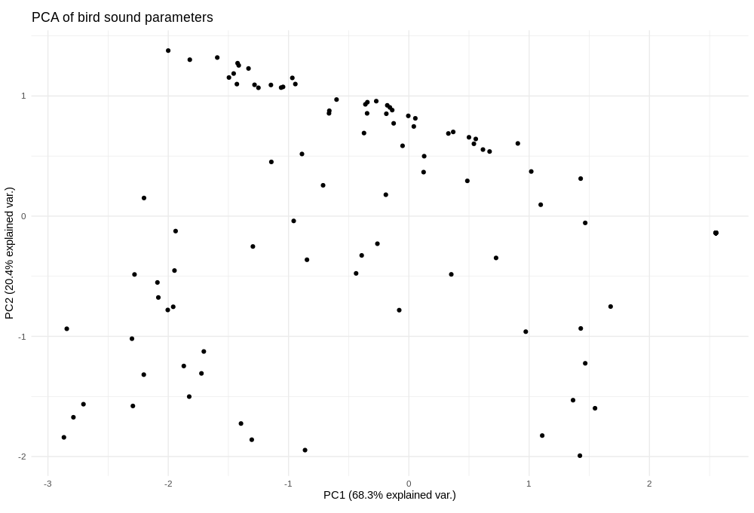
Notes:
So first, I computted a Principal component analysis (PCA) on the sound variables I extracted. Here, The axes 1 and 2 explain over 90% of the variability.
I grouped the different species by main family.

Slide 6
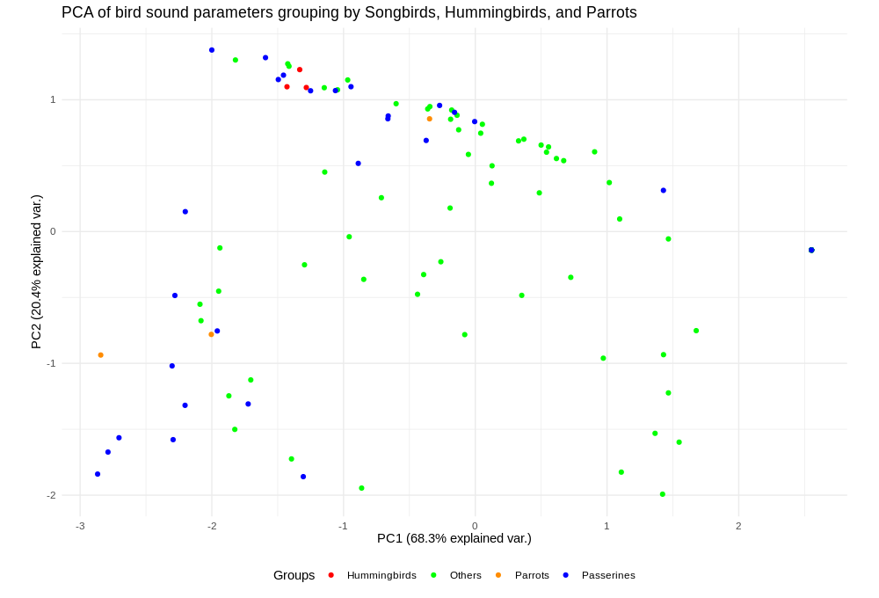

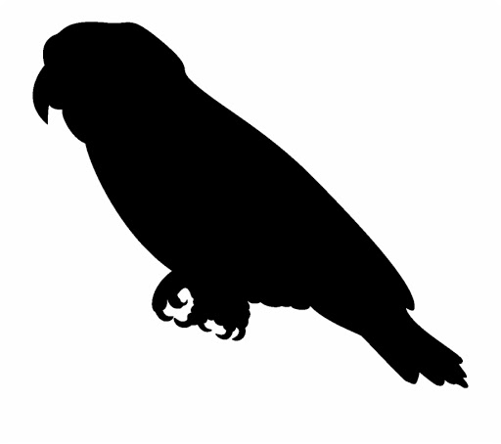
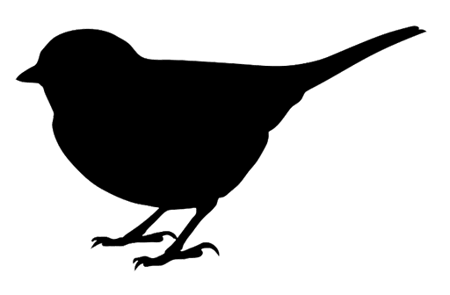
Notes:
You can see songbirds (in blue), parrots (in orange), hummingbirds (in red) and other birds (in green). We notice that Songbirds also known as passerines encompass the other birds on the negative side of PC1.
How can we explain that?

Slide 7
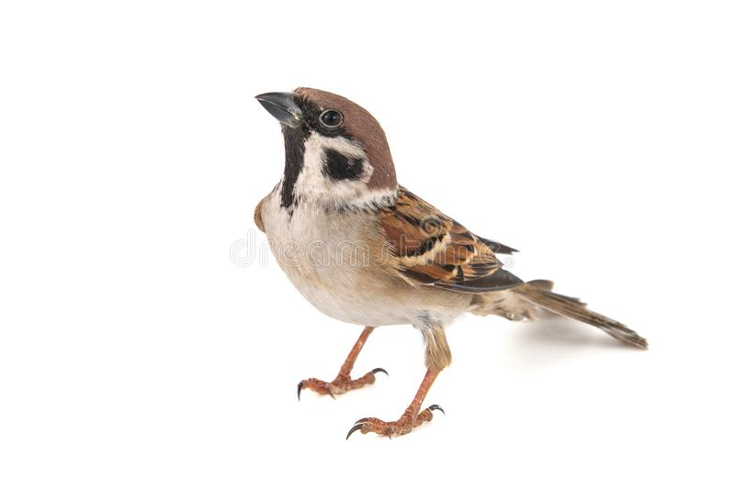
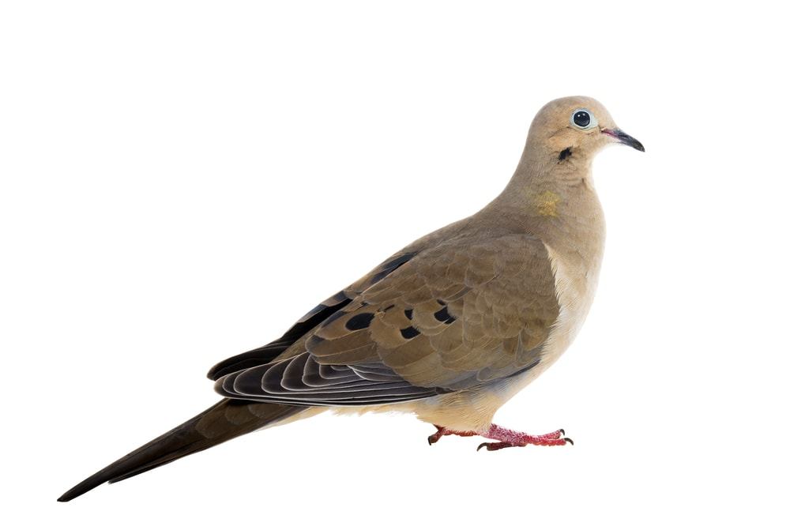
Min Loudness
House sparrow
Max Loudness
Max Pitch
Dove
Notes:
By adding the projection of the variables we see that the negative side of PC1 correlates with the maximum loudness and the maximum pitch. This mean that all species falling on the negative side of PC1 have higher maximum loudness and pitch.
For example. Here, we have … (pas besoin de détailler ce qu’est un house sparrow)
So, we can say that Songbirds have higher maximum loudness and pitches. We observe that hummingbirds also have higher maximum loudness and pitch than the rest of birds. Parrots, in Orange, are more scattered but still on the negative side of PC1. They all have higher maximum pitch but their minimum loudness differs.
This preliminary analysis shows that the phylogeny of a bird seems to explain certain sound parameters, such as loudness or pitch.

Slide 8
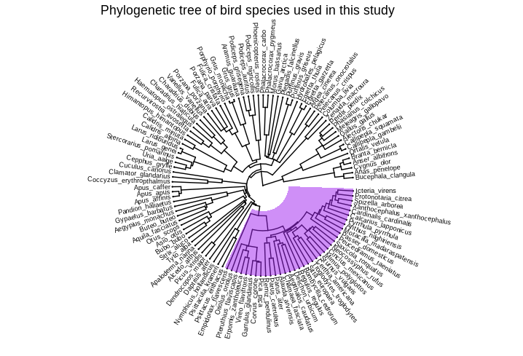

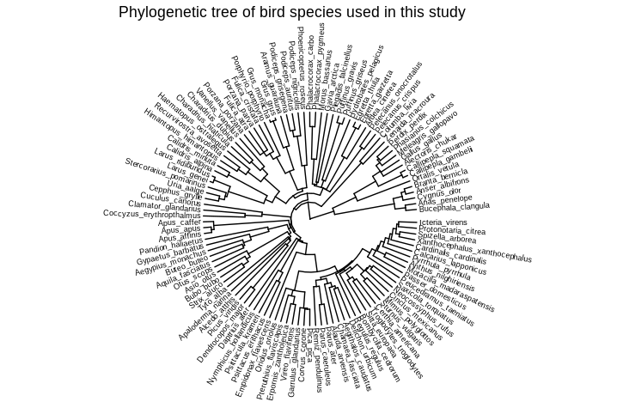
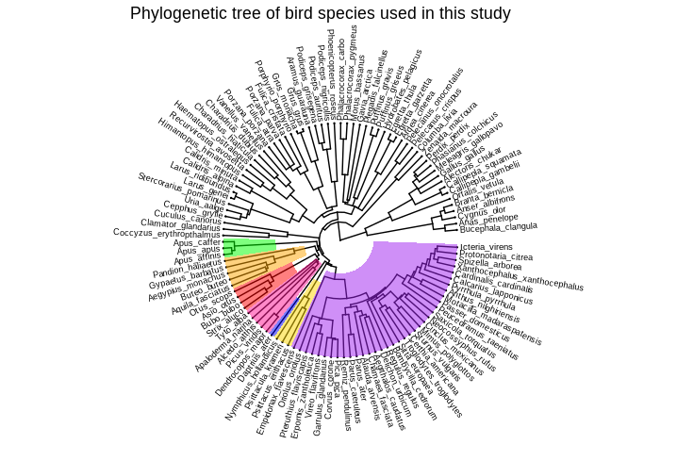
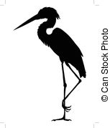
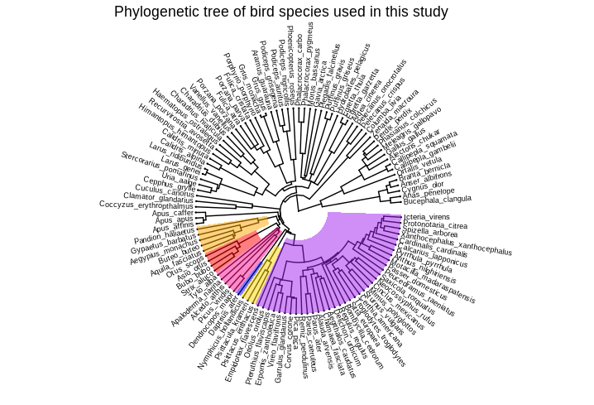
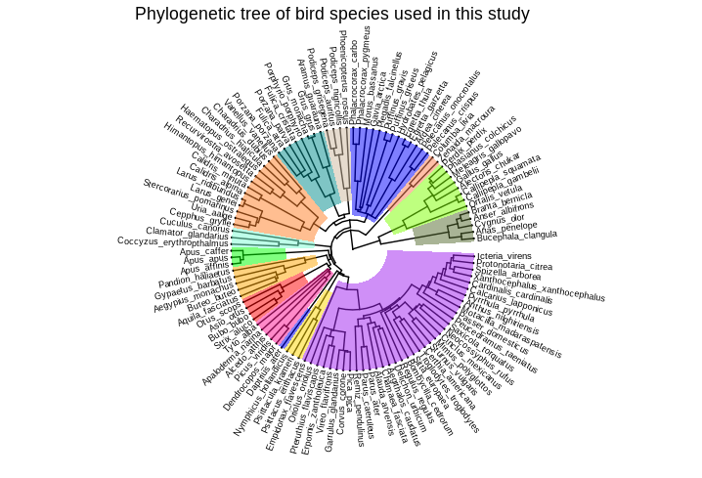

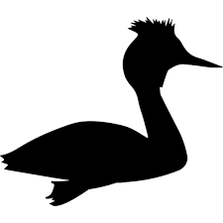
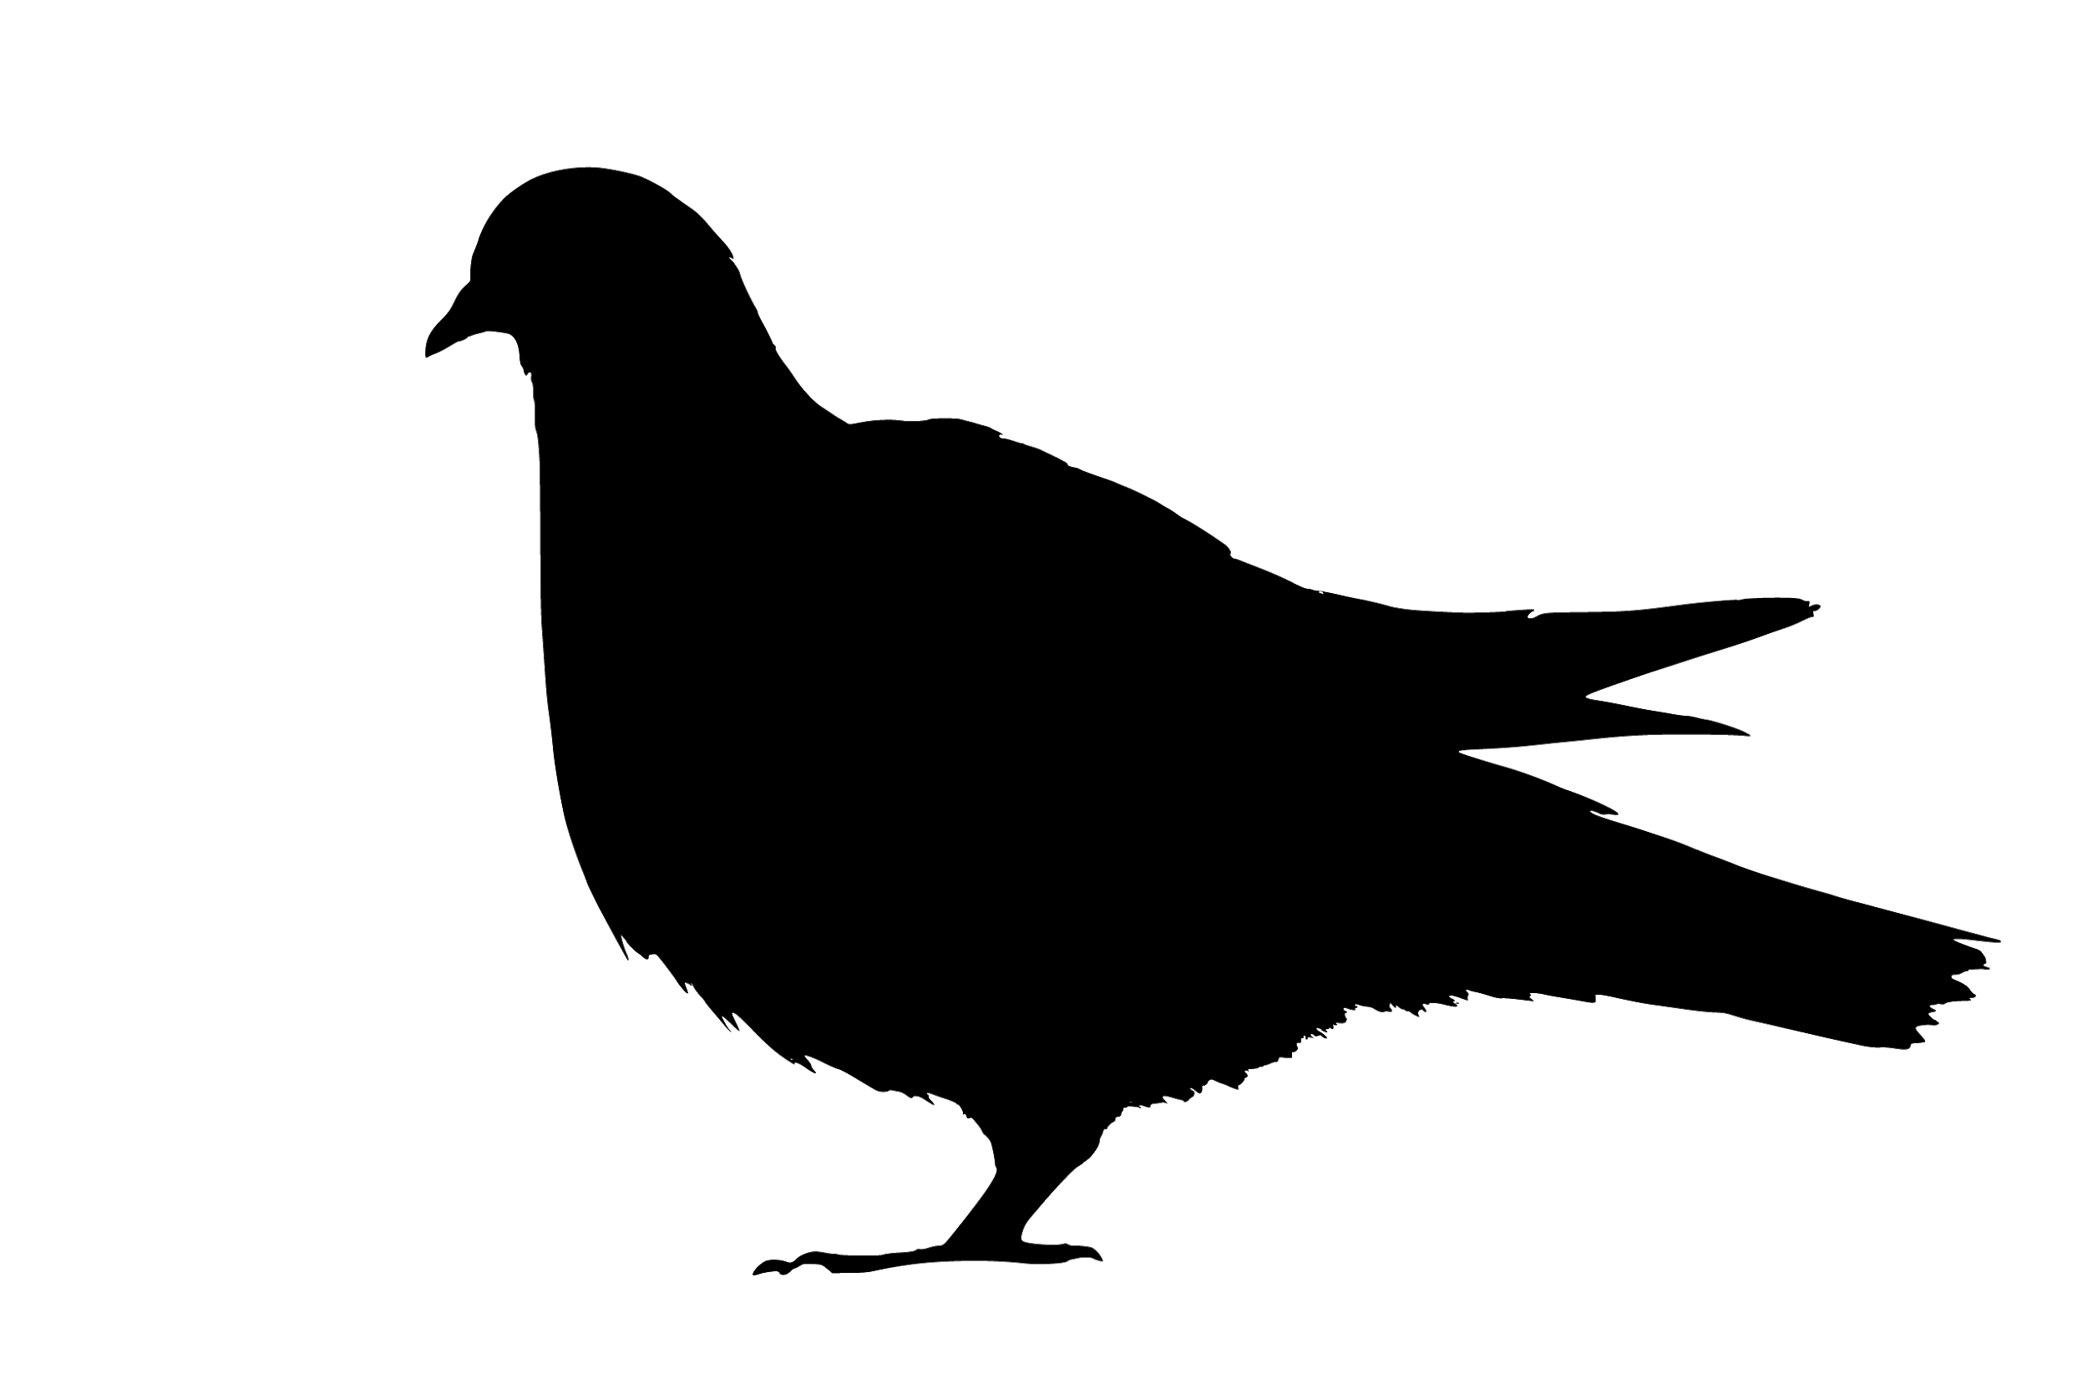
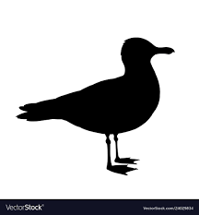
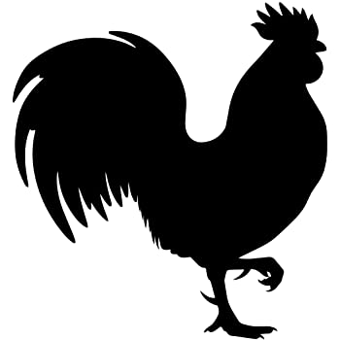
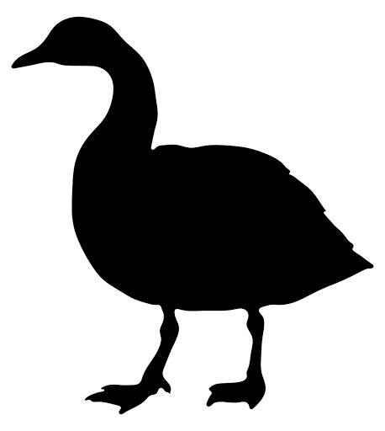
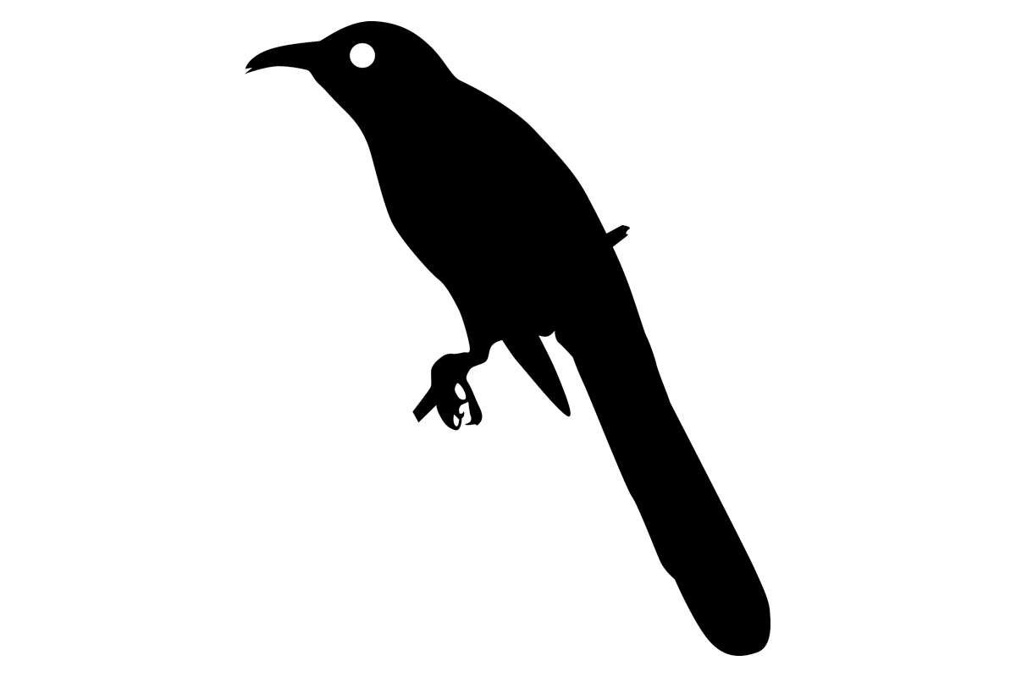

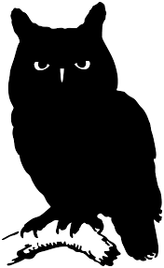

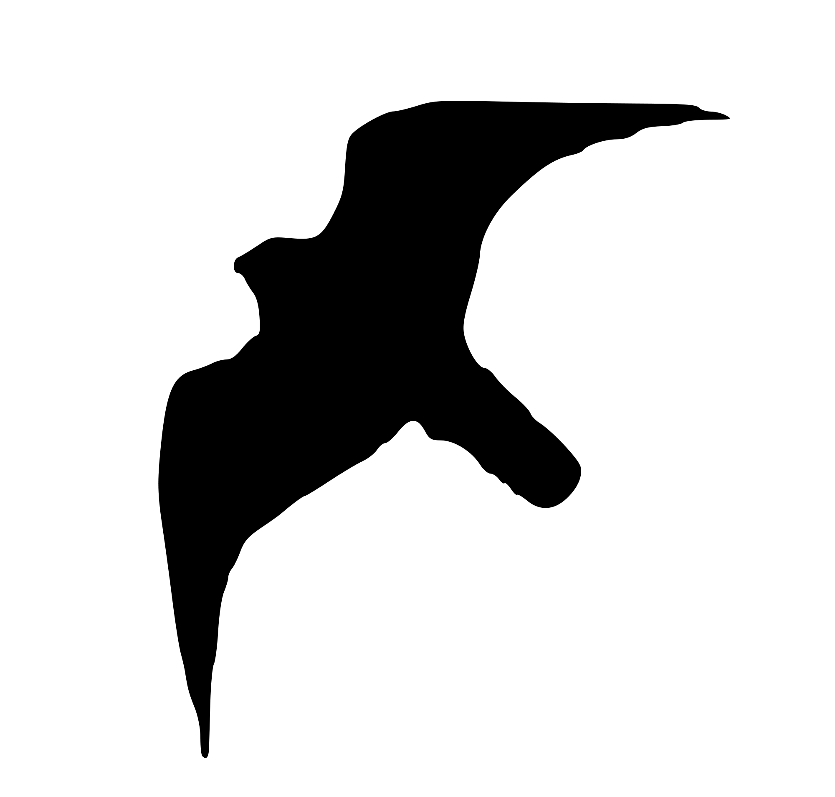
Crane
Grebe
Egret
Pigeon
Gull
Goose
Cuckoo
Hummingbirds
Chicken
Owl
Songbirds
Eagle
Woodpecker
Parrots
Falcon
Notes:
To better visualise this, I built a phylogenetic tree of the studied species
Let me show you where the 3 groups we were just talking about fall on this tree

Slide 9
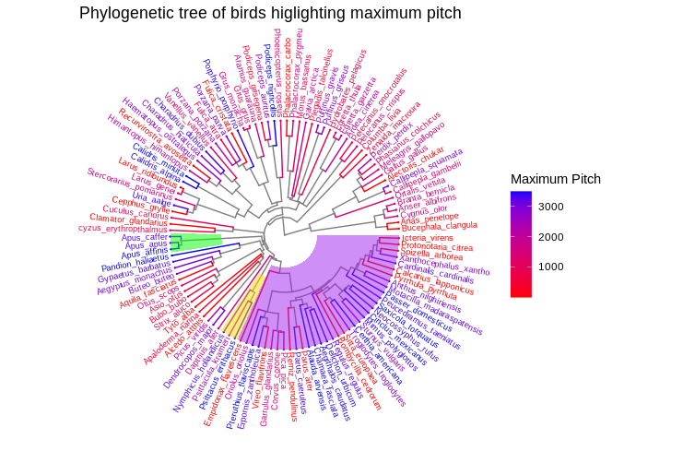
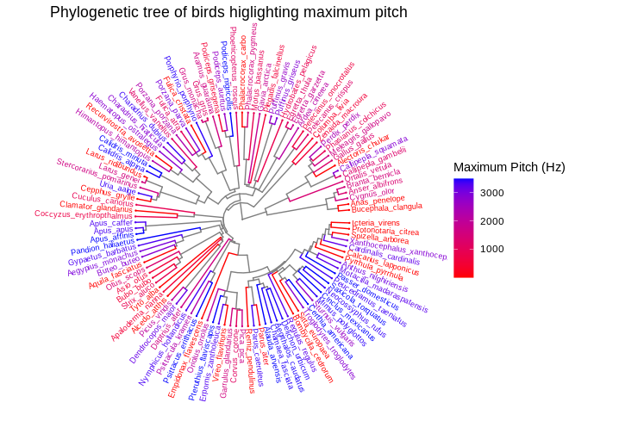
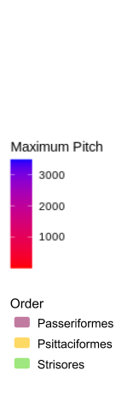
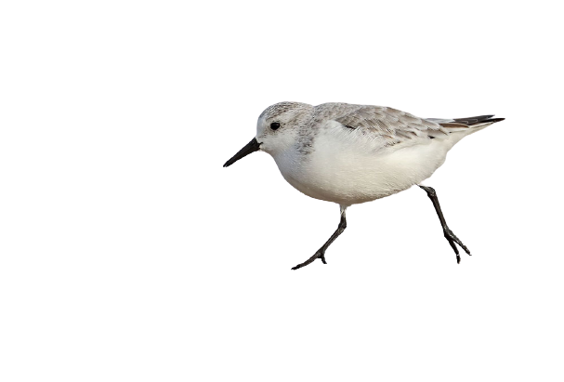
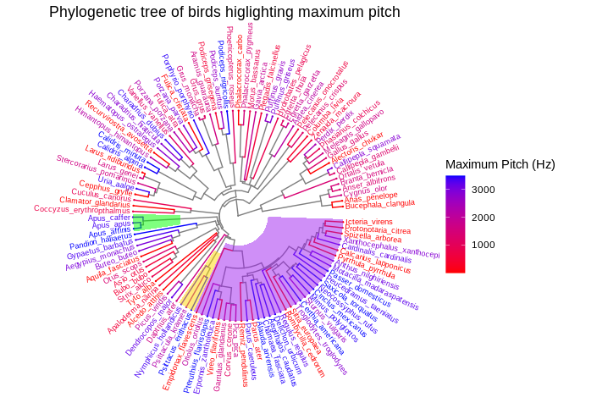
Hummingbirds
(Riede et al 2020)
Songbirds
Caprimulgiformes
Parrots
Notes:
I mapped the maximum pitch reached in each recordings for each species.
We observe that both parrots and songbirds, two sister groups, have higher maximum pitch than many other bird species.
So, there might exist a kinship relationship between the maximum pitch repartition in the bird phylogenetic tree.
I need to dig more to check if this relationship is statistically true, but these results are coherent with the fact that we know that birdsong is related to speciation so we expect the sound produced by a given species to be different from the sound produced by another species.
However, it is interesting to note that Hummingbirds also have higher maximum pitch than other species even if they are not closely related to parrots and songbirds.
It means that other parameters explain the maximum pitch distribution on the phylogeny tree we plotted.
We know that Hummingbird’s vocal organ shows convergence with the one of songbirds.
So, it might be the morphology of the vocal organs also partly explains higher maximum pitch in birds.
In general, the story is much more complicated than that. Some passerines have lower maximum pitches than other birds, and other species from clades not related to parrots, hummingbirds or songbirds show high maximum pitches as well. For example sanderlings from GULLS order have higher maximum pitch, but the rest of gulls have lower maximum pitches.
Here, I just presented a small part of the story, but I am looking forward to showing how other parameters (such as habitat, size, or even nocturnality) could influence acoustic parameters.
In the future, I plan to study the vocal tract morphology of a diversity of bird species to see if the anatomy can predict the sound a bird can produce.

Slide 10

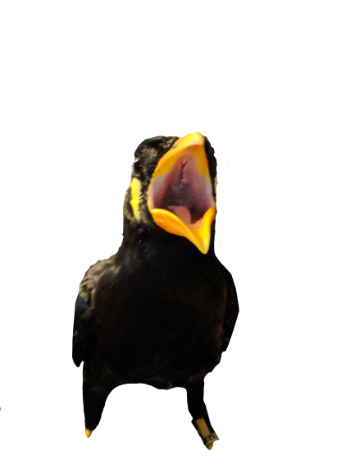
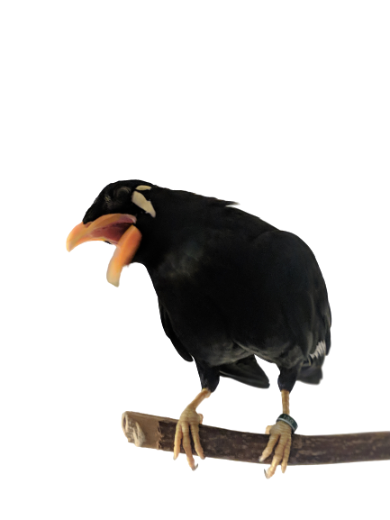



Acknowledgments
hank you for listening !
Charlotte Mangum Student Support Program
T
Charlotte Mangum Student Support Program and SICB
Notes:
I would like to thanks Pauline Provini, Rachel Olson, and the CRI as well as Charlotte Mangum Student Support Program and SICB.
Thank you for your time, do you have any questions?

